Slide 1
Careers Evening Careers Evening Katharine Fry
UCAS and Careers Evening Katharine Fry

Slide 2
When to apply for 2024 entry
16 May
UCAS Undergraduate Apply opens for 2024 entry.
16 October
UCAS Application deadline for courses in medicine, veterinary medicine/science, and dentistry, and courses at Oxford or Cambridge.
31 January
UCAS Equal consideration application deadline.
February
UCAS Extra opens.
End of June
Last date for applications before Clearing opens.
5 September 2023 – Completed applications can be sent to UCAS
23 February 2023
| 2

Slide 3
The Royal School Application Timelines
15th September 2023 – UCAS Music Conservatoires deadline (2nd Oct 23)
22nd September 2023 – Early Entrants: Oxbridge, Medicine, Dentistry, Veterinary (16th Oct 23)
20th October 2023 – All other applications RSS Guideline for Submission (31st January 2024)– Deadline Equal Consideration) – Earlier submission strongly advised
~ May 2024 – University Decisions back
~ June 2024 – Firm & Insurance choice made

Slide 4
Applying - key facts
Register with UCAS via the Hub
Use your username and password to apply online
Students can add up to 5 choices, unless they’re applying to study medicine, veterinary, medicine/science, dentistry – then it’s 4 choices
Students can’t apply to BOTH Oxford and Cambridge
Applying costs currently £27.50 (billed)
Apply by the equal consideration date
Providers can’t see other choices when you apply

Slide 5
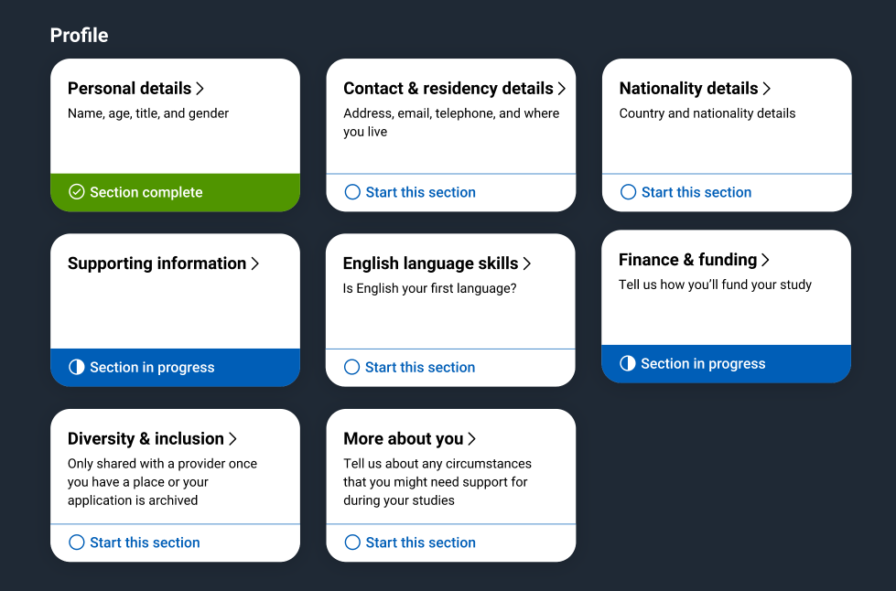
Making an application
Profile:
Personal details
Contact and residency details
Nationality details
Supporting information
English language skills
Finance and funding
Diversity and inclusion
More about you
| 5

Slide 6
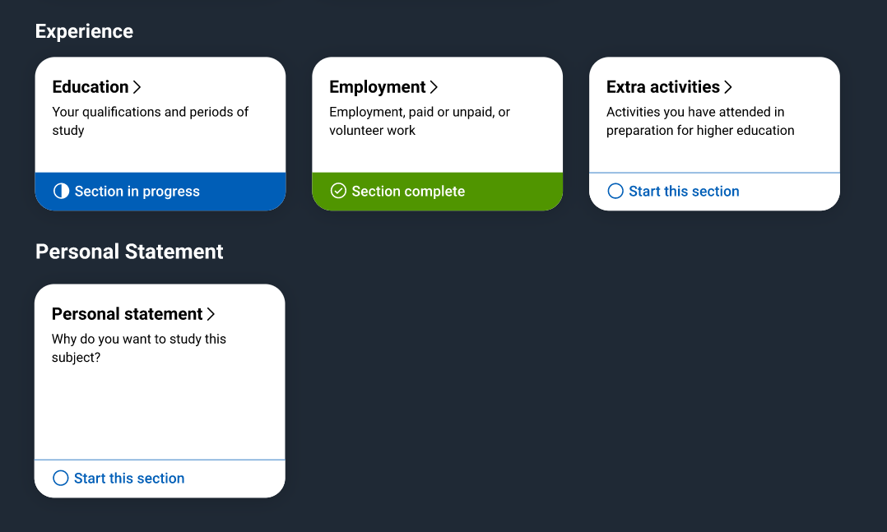
Application
Experiences:
Education
Employment
Extra activities*
Personal statement
Reference**
Add choices – up to five
* (for students with a UK home address)
**(not visible for students linked to their school/college)

Slide 7
Completing the UCAS application
Students register for a UCAS Hub account – during June UCAS Day
Student complete their application – working their way through all sections and send it to their school / college
Teachers/advisers review the application and add reference and predicted grades
Applications are sent to UCAS by the school on behalf of the student
Universities/ colleges make their decisions
Security marking: PUBLIC
23 February 2023
| 7

Slide 8
Decisions
Universities and colleges will review the:
They may also ask for:
personal statement
admissions test
qualifications
interview
reference
portfolio/audition
Security marking: PUBLIC
23 February 2023
| 8

Slide 9
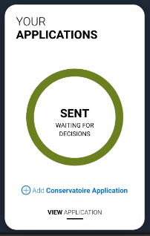
Tracking Applications
Head to UCAS Hub to:
follow its progress 24/7
see choices and personal information
view offers
reply to offers online
One of three decisions will be made:
unconditional offer
conditional offer
unsuccessful
| 9

Slide 10
Replies to offers
Once decisions have been made on all choices, two can be chosen:
one as a ‘firm’ acceptance – first choice
the other as an ‘insurance’ acceptance. This acts as a back-up if you do not get into your ‘firm’ choice
Any remaining offers must be declined.
Once all decisions and replies have been made, if you are not holding an offer, you may be able to use Extra or Clearing to find available places.
| 10

Slide 11
Other options
Extra (Feb – Jul)
Used all five choices and had no offers.
Add Extra choices for consideration one at a time.
Clearing (Jul – Oct)
Apply after 30 June, receive no offers, decline all offers, not met conditions.
Find vacancies from early July and add a Clearing choice to your application.

Slide 12
UCAS Tariff
Grade | A level | AS level | EPQ
A* | 56 | - | 28
A | 48 | 20 | 24
B | 40 | 16 | 20
C | 32 | 12 | 16
D | 24 | 10 | 12
E | 16 | 6 | 8
https://www.ucas.com/ucas/tariff-calculator

Slide 13
FAQs
Order of universities in application does not matter
Oxbridge & Early Entry – subject support, interview support
Can submit with less than 5, add more in later
Course choices can be changed in first 14 days
UCAS – www.ucas.com/parents
Discover Uni - Mrs Lilley and Mrs Fry use this website when talking through choices with pupils. In time there will be greater data available through UCAS - later this year the entry grades tool will be available on ucas.com, to give students visibility over a range of grade profiles accepted for entry, to courses over a five-year period (where data is available).

Slide 14
FAQs
Student Finance England – student applies first then parent confirms income section based on previous tax year
Finance Applications open Feb/March – Deadline May
https://www.gov.uk/student-finance-register-login
https://www.gov.uk/apply-for-student-finance/parents-and-partners
https://www.gov.uk/support-child-or-partners-student-finance-application

Slide 15
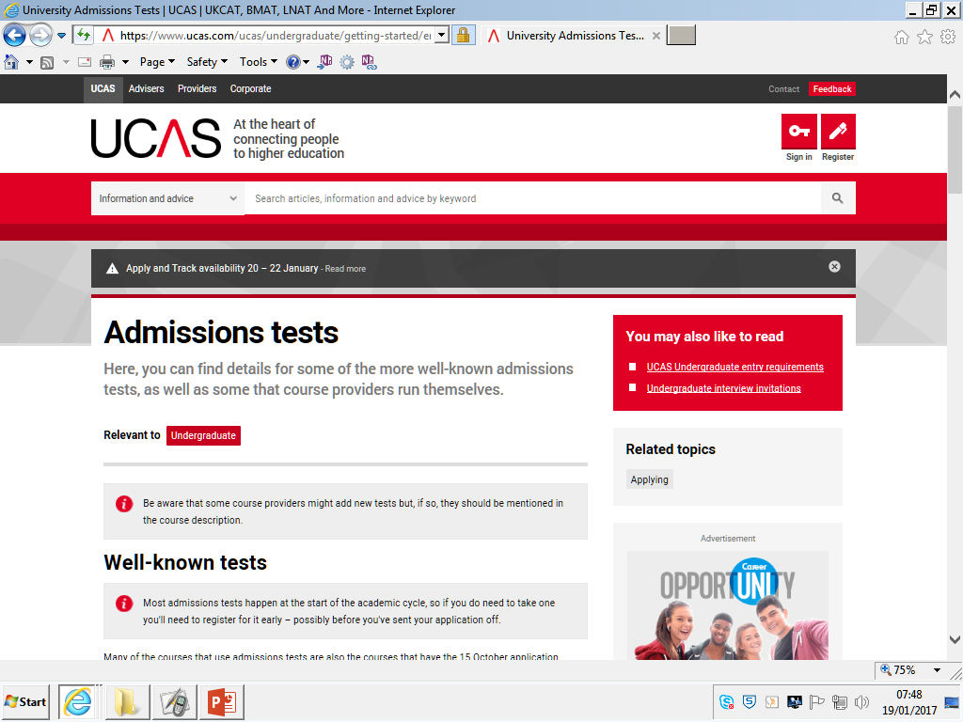
Admissions tests:
UCAS has all the details: search UCAS admissions tests
https://www.ucas.com/ucas/undergraduate/getting-started/entry-requirements/admissions-tests

Slide 16
Admissions tests:
A number of courses require applicants to sit admissions tests in addition to normal grade / points requirements.
Some Early Entry courses have this requirement:
Oxbridge courses
Medicine – BMAT, UKCAT, etc.
But also many courses, for example:
Law – LNAT
Mathematics – MAT, STEP

Slide 17
Admissions tests:
Check whether chosen courses has an associated admissions test
Check the date by when you need to apply to sit it
Especially for Early Entry courses, be aware that the test application date may be relatively early in the school year, sometimes they are in October half-term.
Guidance about the tests and sample papers are available through the UCAS website - student responsibility to prepare for these, subject support available
It is the applicant’s responsibility to identify and register for these tests, please speak to Mrs Fry, Mrs Lilley or Mrs Bell

Slide 18
Admissions Tests
Reforms to Cambridge Assessment Admissions Testing from 2024
Cambridge Assessment Admissions Testing is to withdraw from running a series of university admissions exams with effect from 2024-5. This includes BMAT (medicine), ENGAA (engineering), NSAA (natural sciences) and TMUA (mathematical skills) tests.
For the academic year 2024/25 onwards, the seven UK medical schools that use BMAT tests as part of their admissions process (Brighton and Sussex, Imperial, Lancaster, UCL, Cambridge, Leeds and Oxford) as well as medical and healthcare schools in other countries will put alternative arrangements in place.

Slide 19
Admissions Tests
There will be no change for this year's entry system, as Cambridge Assessment Admissions Testing services will continue for 2023.
To minimise disruption, the University of Cambridge is considering alternatives. ENGAA (engineering), NSAA (natural sciences) and TMUA are currently used for pre-interview selection to some courses at the University.

Slide 20
Personal Statement
Student’s responsibility
Written with our support
A significant part of application
May be used to support application if grades not quite achieved – stand out from the crowd
4,000 characters including spaces – lots of templates but beware of plagiarism – UCAS plagiarism software
We have asked for ‘rough’ draft before the end of Summer term

Slide 21
Personal statement - content
Understanding of the Course
Independent Study Skills
Self-awareness (strengths, qualities, leadership)
Motivation and Commitment
Good Numeracy and Literacy
Time Management Skills
Going Beyond the Syllabus (work experience / reading)
Relevant transferrable skills (leadership, essay writing)
Southampton Univeristy offer a statement one-to-one clinic

Slide 22
UCAS Reference Changes…
The reference sections will be completed by Mrs Lilley

Slide 23
Predicted Grades
Predicted grades – based on best evidence and performance during Y12 and start of Y13
Predictions will be provided by individual subject teachers

Slide 24
Following Submission
UCAS Hub – shows status of each application
Mock interviews support available – RSS/UL
Applicant Days
Admissions Tests if needed (some on site, some external – faculty support with these)
Extra & Clearing
Incentivisation – reduced or unconditional offers for Firm Choice or a good EPQ grade
Accommodation applications

Slide 25
What can students be doing?
research, research, research
attend open days and events – including online
extracurricular and supercurricular activities
work experience
volunteering
independent learning outside the curriculum
focus on this year’s studies
23 February 2023
| 25

Slide 26
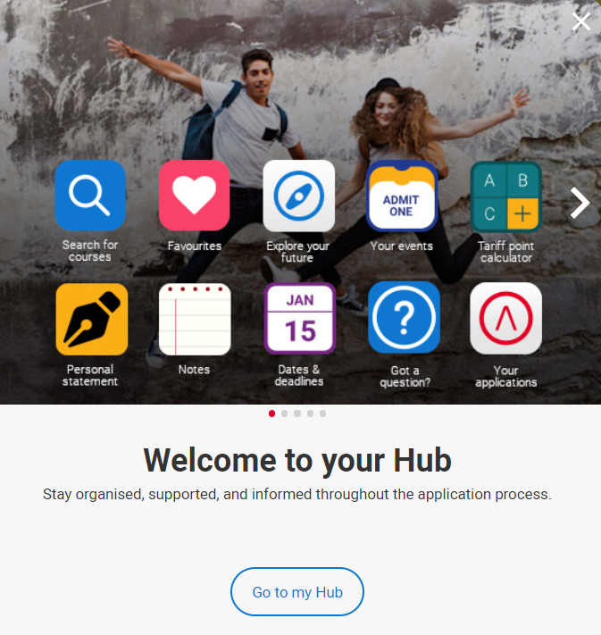
Starting your research
Register with the UCAS Hub to:
explore careers, subjects, places, and apprenticeships
find and favourite from over 35,000 courses
search for open days, online events, and virtual tours
turn predicted grades into UCAS Tariff points
speak to those in the know using Unibuddy
speak to career, higher education, and application specialists by attending the Hub lives
take the UCAS Quiz to find your career matches
start an application for 2024 entry (from May 2023)

Slide 27
How can you support them?
Research
Use the parents/guardians’ section of the UCAS website at www.ucas.com/parents.
Sign up
Sign up for parent updates from UCAS and get everything you need to know about the application process direct to your inbox.
Open days
Attend virtual events and open days – you may have a different perspective.
Be proactive
Make sure they read everything carefully that is sent to them and don’t book holidays at key times!
Discuss ideas and please talk to us if you have any questions
23 February 2023
| 27

Slide 28
Gap Year Taking a Gap Year
A productive year can be valuable on your CV – developing skills and experience
A gap year can enhance your university studies – you can tailor your gap year to relate it to the subject area you plan to study.
A gap year can generally allow students to become more focussed and responsible
Ideas: Volunteering, paid employment, work experience, part-time courses, Internship

Slide 29
Gap Ideas – some inspiration
Year Out Group - https://yearoutgroup.org/
Real Gap Experience - https://www.realgap.co.uk/experiences-adventures
BUNAC - https://www.bunac.org/uk
Surrey Volunteering - https://www.surreyvolunteering.com/
https://www.studentladder.co.uk/

Slide 30
Apprenticeships
Check out ucas.com/apprenticeships to find out more, including:
degree apprenticeships
how to find and apply for apprenticeships
preparing for application and interview
browse our industry guides
Sign up at careerfinder.ucas.com to search for apprenticeships and internships vacancies.
23 February 2023
| 30

Slide 31
Intermediate – degree level
Employed
Off the job
Paid a salary
Typically 1-6 years
Real responsibilities
600+ standards
Contract
Not the easy option

Slide 34
What are the differences with traditional Degrees?
Advertised all year
UCAS deadline
Student pays to study/student loan
Employer and Government pay for the study
Start at points throughout the year
Usually start once a year

Slide 35
What are the similarities with traditional Degrees?
The need to do your research
Apply and its competitive!
Entry Requirements
You can still graduate!

Slide 36
5 miles
85
10 miles
288
20 miles
713
30 miles
2629
England
1000
Dec 2022

Slide 37
Closing date
Weekly salary
Job opportunity
Annual salary
Recruitment Consultant
Technical Resources Limited L3
Nov 22
£384
£19,968
Assistant Business Administrator NHS L3
Feb 23
£356
£18,546
Construction Management MACE L4
Sept 23
£365
£19,000
Project Manager Unilever L4
Sept 23
£326
£17,000
Project Mgment Surveyor Historic Royal Palaces Degree
Dec 22
£488
£25,418
Digital Marketing
Unilever Degree
Sept 23
£269.25
£18,000
Dec 2022

Slide 39
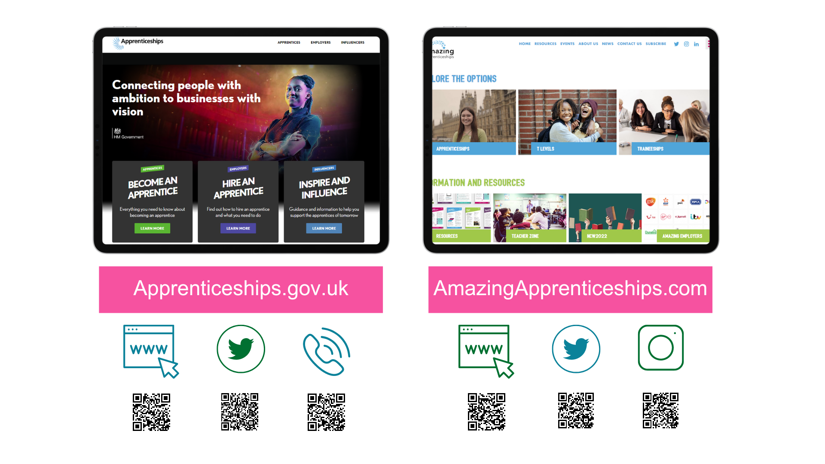
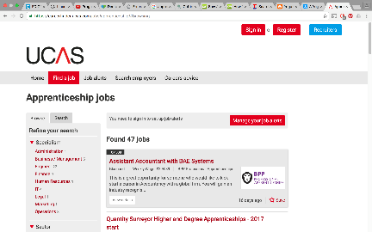
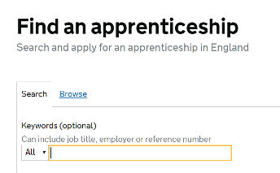
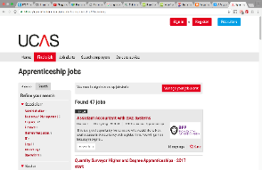
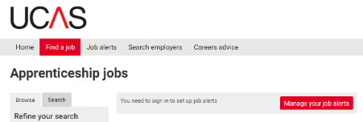
amazing
Start looking and applying from Oct/Nov time in Y13
ALPS will deliver a talk on the UCAS Day

Slide 40
Sources of Further Information
www.notgoingtouni.co.uk
www.apprenticeshipguide.co.uk
www.allaboutschoolleavers.co.uk
www.getmyfirstjob.co.uk
www.future-talent.com
www.thebigchoice.com
www.studentladder.co.uk

Slide 41
Closing Points...
All Y12 have a scheduled one-to-one careers appointment with myself to talk through their options, these have already been taking place. HE has also been explored during FR and careers lessons
UCAS Exhibition – 21st April 2023: Y12 will be going to this event in Farmborough, where they will have access to over 100 different university representative and seminars
June 2023 – Y12 UCAS & Beyond Day
Request further meetings to see us if they have any questions, pupils should be proactive

